Slide 1
What is a Little Trooper?
Someone who handles adversity well
Courageous, persistent person
All children of our British Armed Forces personnel are Little Troopers

Slide 2
Little Troopers the charity
Founded originally in 2011
Following founder Louise finding a letter her daughter wrote while
her dad was in Afghanistan
2021 sees us celebrating our journey and existing for 10 years
supporting all children with one or both parents serving in the
Regular or reserve British Armed Forces, there are over
100,000 military children out there who need us!

Slide 3
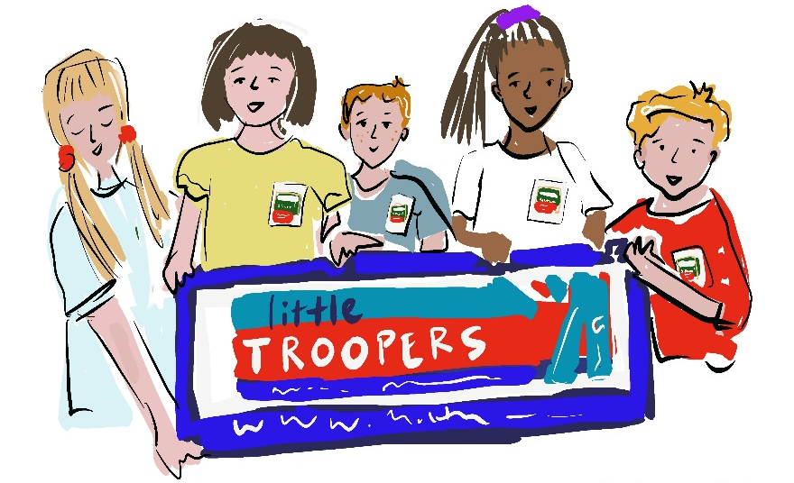
Our values
Inclusion
Insuring children feel included and in control of any military life hurdle they face
Recognition
Recognising that Little Troopers are special and their unique daily challenges are seen
Celebration
Celebrating being part of the British Armed Forces community

Slide 4
Who is supported?
Little Troopers is the charity supporting children of our British Armed Forces (there are in excess of 120,000) who can face daily unique challenges due to being a part of a military family; long periods of separation, operational deployments, moving home and school frequently to name a few.
Children with parent(s) serving in the regular or reserve British Army, Royal Navy and Royal Air Force is the ONLY eligibility…..rank, location, service, martial status don’t matter
Married Unaccompanied – dispersed families
Families living in military accommodation
Divorced/Separated families
Co-habiting families
Single serving personnel with children

Slide 5
What challenges are military children navigating?
Military children can experience life differently from their peers
Families are always coping with unexpected change and uncertainty which can impact on family life
Having a parent deployed or serving away from home on exercise
Moving home and school frequently
Living unaccompanied
Important to realise that military children are not necessarily resilient to these experiences just because they happen all the time.
Having a parent away on exercise for a few weeks can be just as hard for some children as a longer deployment

Slide 6
Provision
Resources - Separation Packs, Send a Hug kits, Story books
Initiatives – Birthday Scheme, Little Troopers Letters, Little Troopers Treasures App, Little Troopers at School, Little Trooper of the Month, Little Troopers Gazette, Christmas Smiles
Website – Information Sheets, Crafty Little Troopers activities, Downloadable child certificates, Recommended Reads, Family Time podcasts,
Shop for Little Troopers – Hoodies, T-shirts, hair bows, military child items

Slide 7
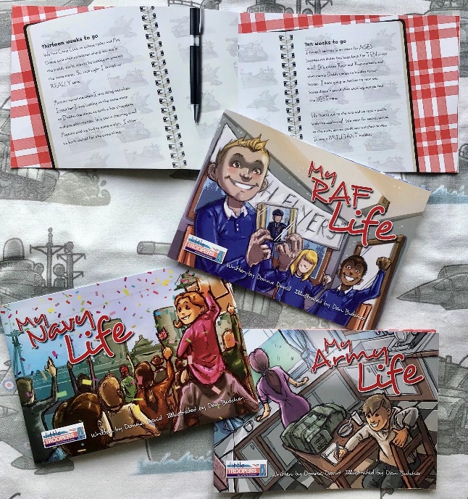
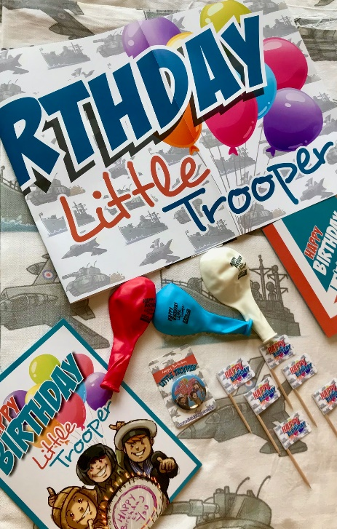
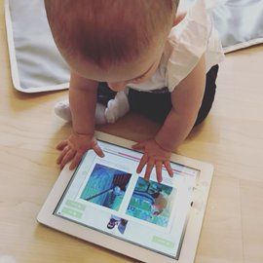
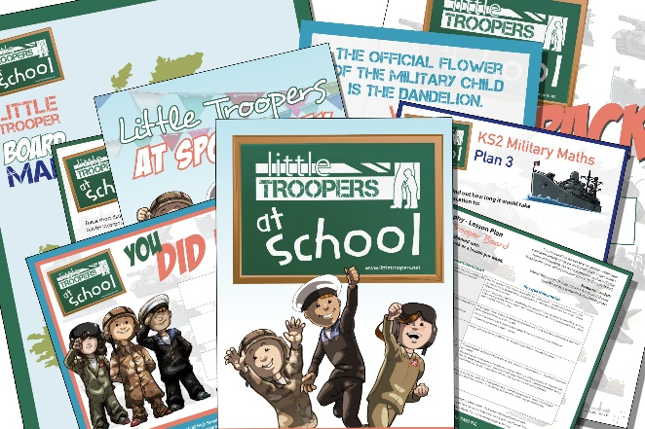
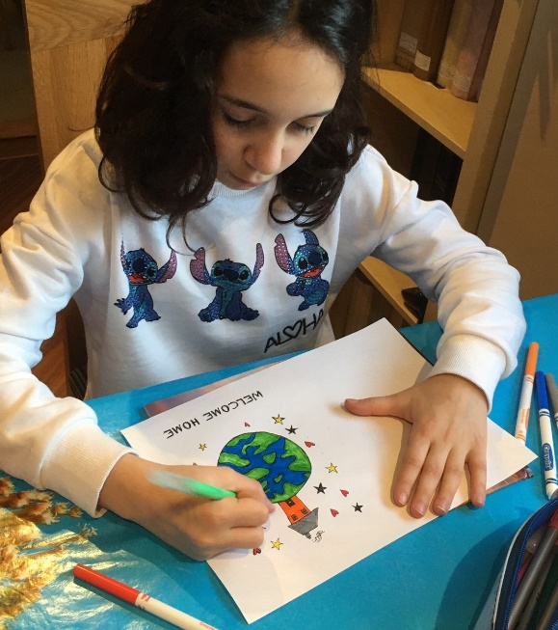
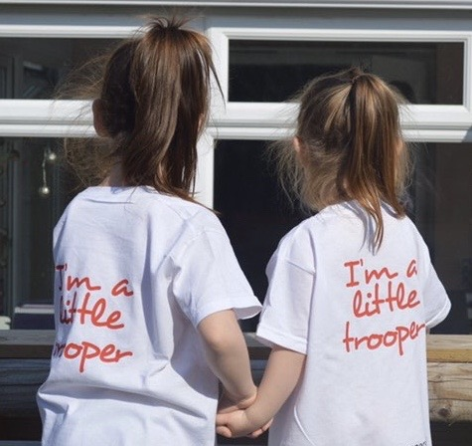
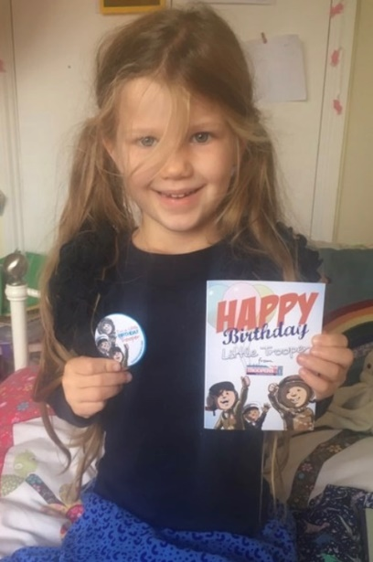
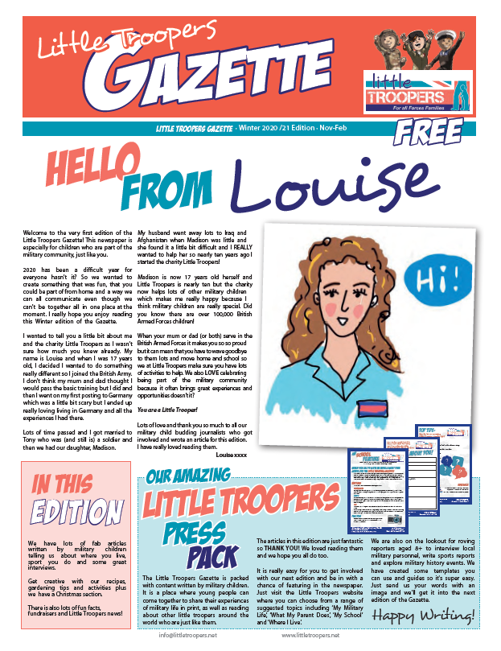
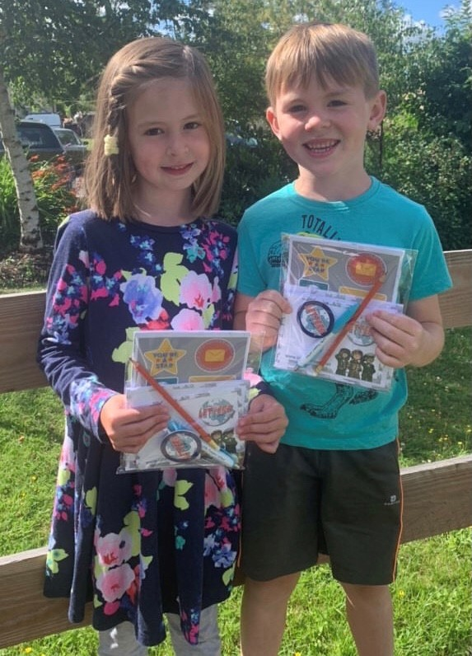
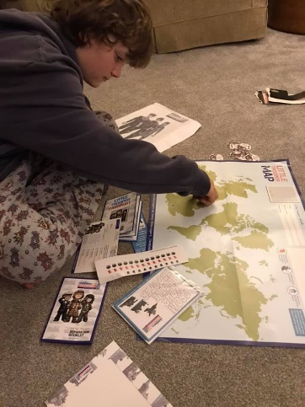

Slide 8
Little Troopers at school
How can Little Troopers help education settings?

Slide 9
Project overview
Little Troopers at School project was launched in 2018 to help schools understand the challenges military children can face and provide lots of age specific, appropriate resources for education settings to help promote inclusion and recognition
What is available for you now?
Free Information Sheets – Schools & Parents
Recommended reads list
Schools website section
Primary School Resource pack
Specific schools quarterly newsletter
Story book series
Crafty Little Troopers
Primary School Wellbeing Course
Additional needs resources – talking mats & social stories
Secondary Wellbeing Course
Forces Life Club
SQUAD podcast

Slide 10
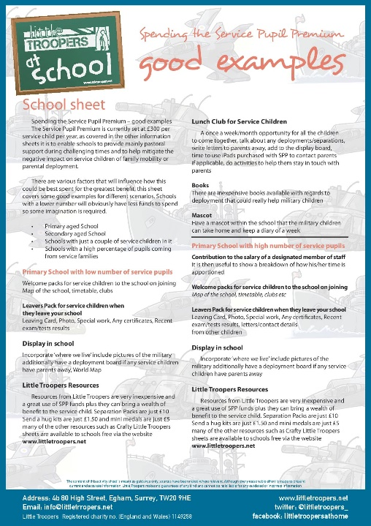
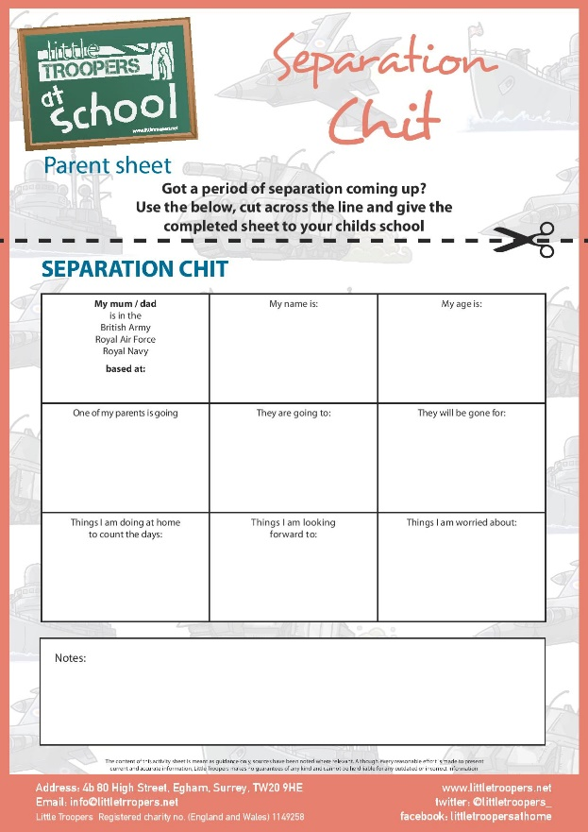
Information Sheets
Parent & School sheets
Term Time absence
Service Pupil Premium
Challenges faced
Transition
Separation
Additional needs resources
Making the forms available in school
Appreciating if forms come in
Asking at parents evening about separation periods
Recognising the challenges faced, lack of roots etc

Slide 11
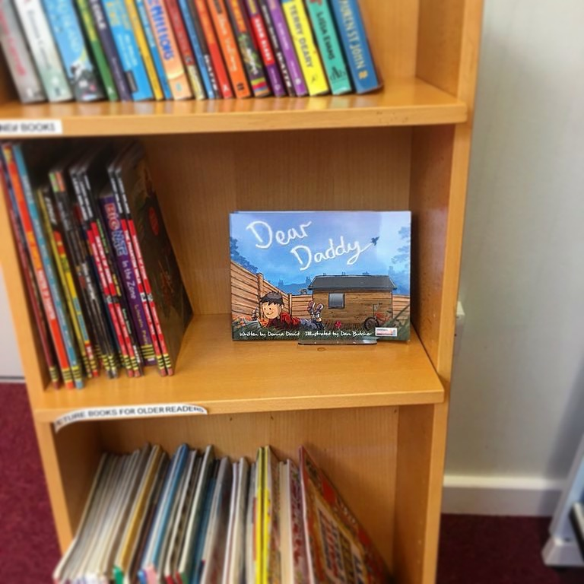
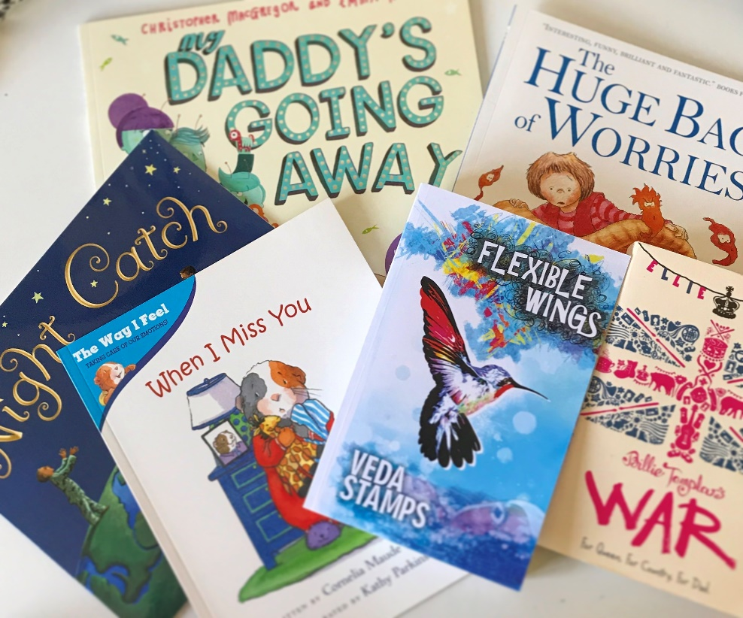
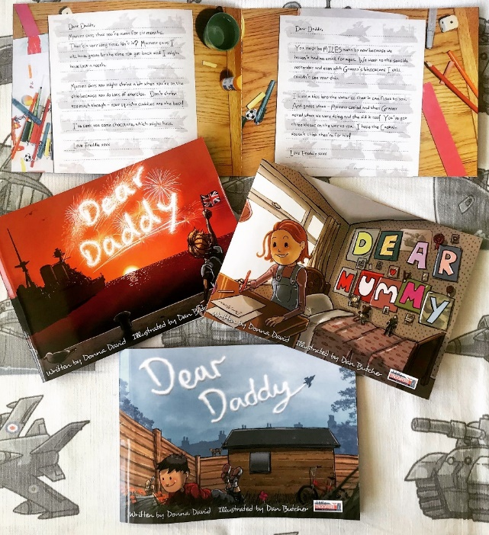
Recommended Reads

Slide 12
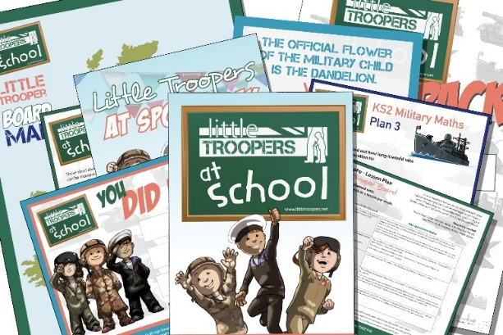
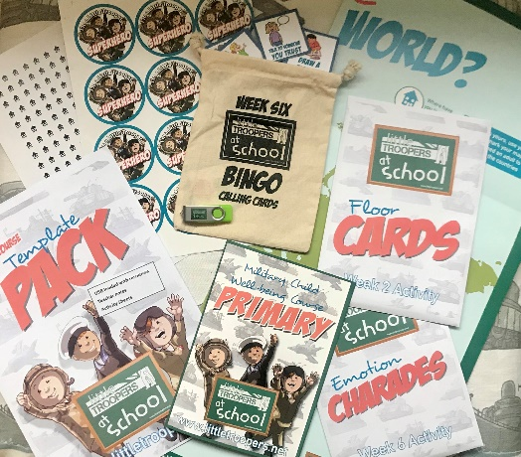
Primary school packs
Schools booklet
USB – Loaded with Role Play Props, Certificate templates, Forms, Separation Diary
Activity Sheets – Bingo, Military life timeline, Poppy, Memory Jar
Lesson plans – 2 x Literacy 4 x Maths
Role Play plans – RAF, Army & Royal Navy
Circle Time scenarios – x 5
Little Trooper Board – Maps, Stickers, Poem, Location Cards (and template)
Short Story – written by published author Tom Palmer
Intro booklet
USB (loaded with 32 documents)
A1 Map
Stickers
Bingo calling cards in pouch
Floor Cards
Charade Cards
Session 1 – Mindfulness Session 2 – Belonging/Identity Session 3 – Creative Writing Session 4 – Separation/Deployment Session 5 – Superhero’s Session 6 – Change Session 7 – This is Me
RESOURCE PACK
One pack supports up to 25 children
WELLBEING COURSE TEMPLATE

Slide 13
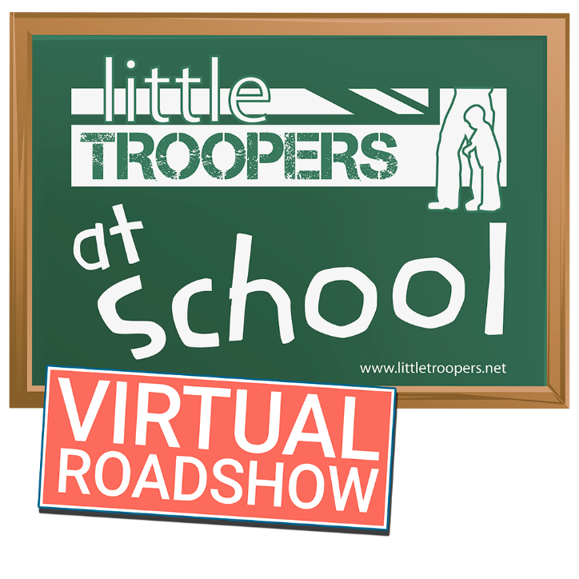
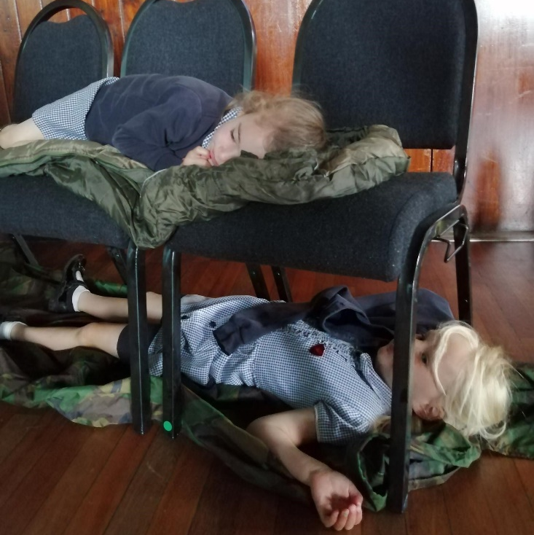
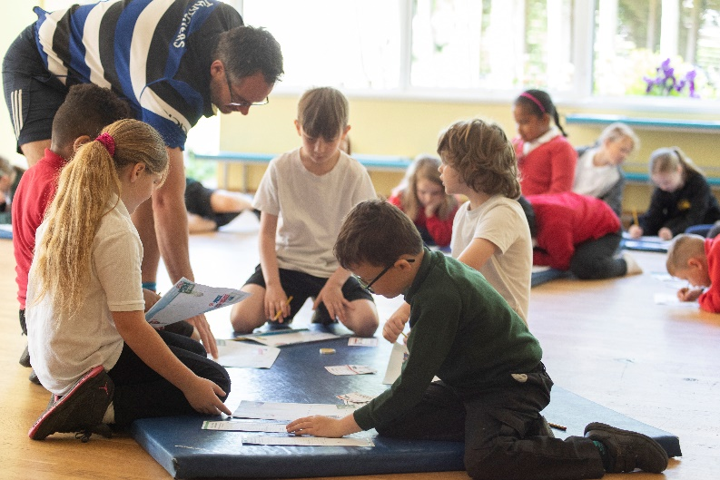
Primary school virtual roadshow
Over 3400 military children took part
Now available via our website to replicate

Slide 14
New secondary resources
Resource Hub
- Resources for Schools
- Resources for use with military children
- Forces Life Club

Slide 15
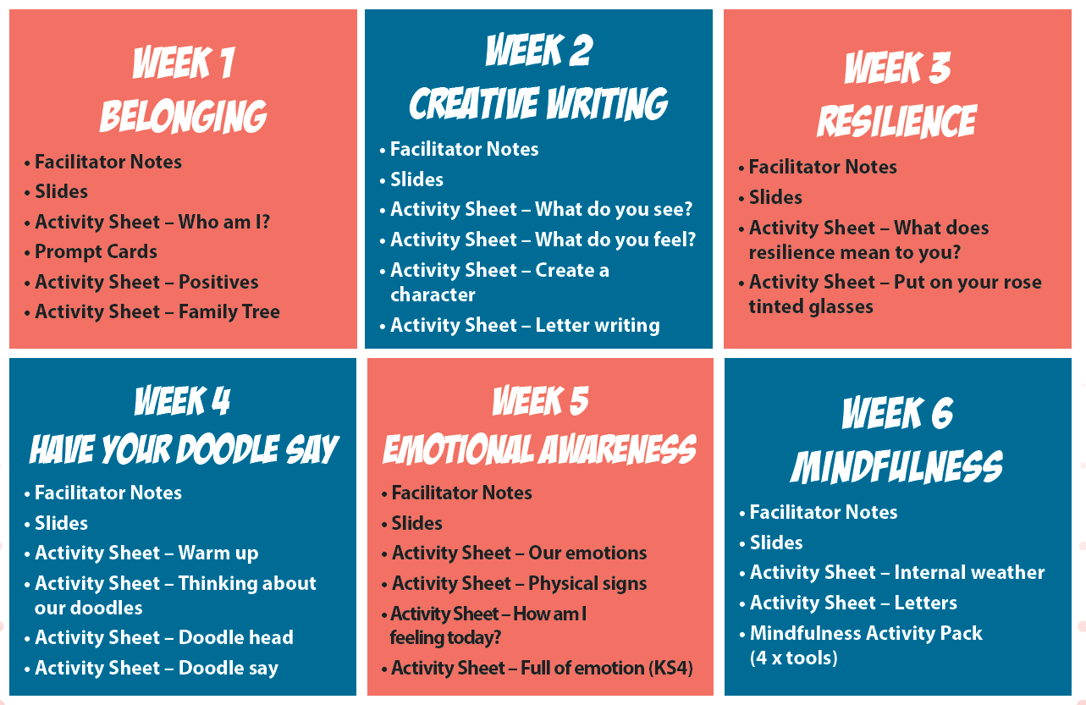
New secondary resources
Wellbeing Course
- Free to schools
- 6 week course template
- USB loaded with all resources required – powerpoints, facilitator notes, activity sheets
Request course via our website

Slide 16
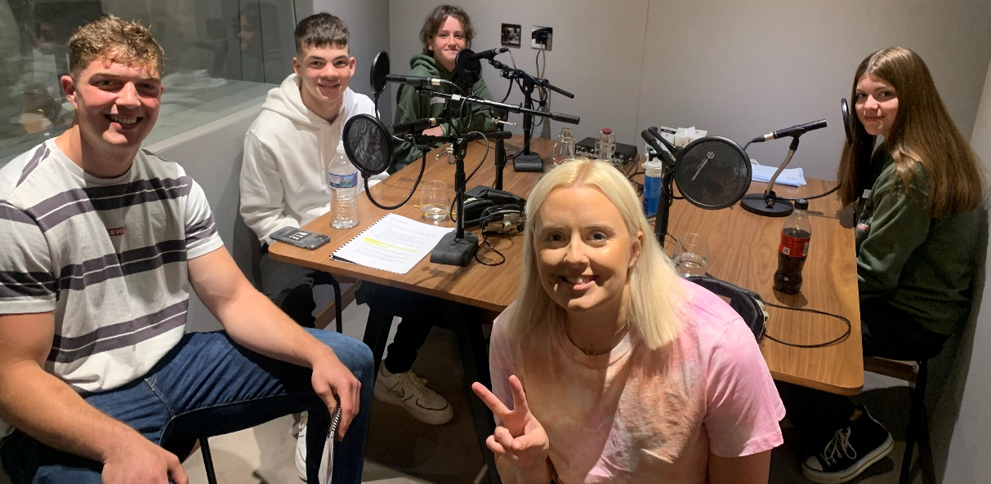
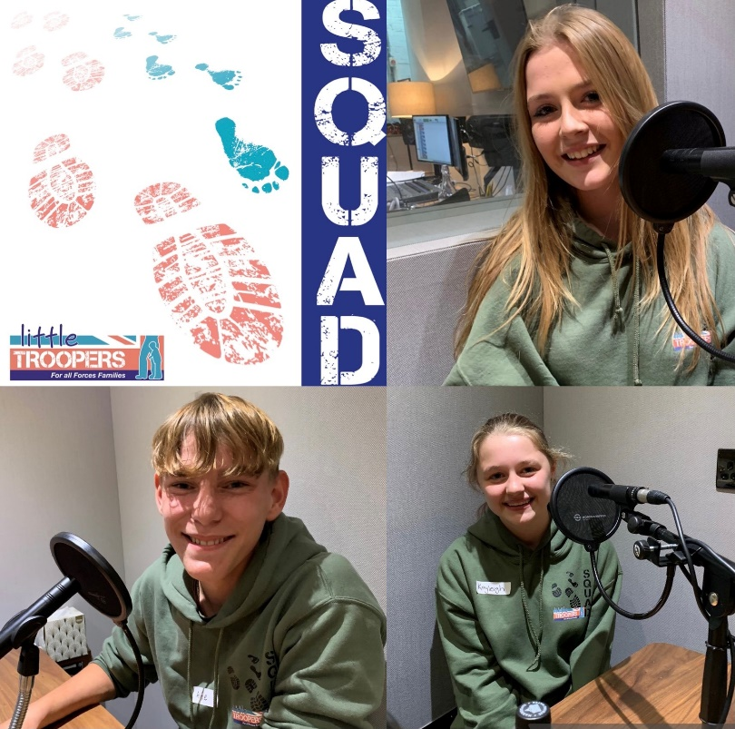
New secondary resources
SQUAD podcast
- Free to schools
- 8 episodes
- Great to open discussions

Slide 17
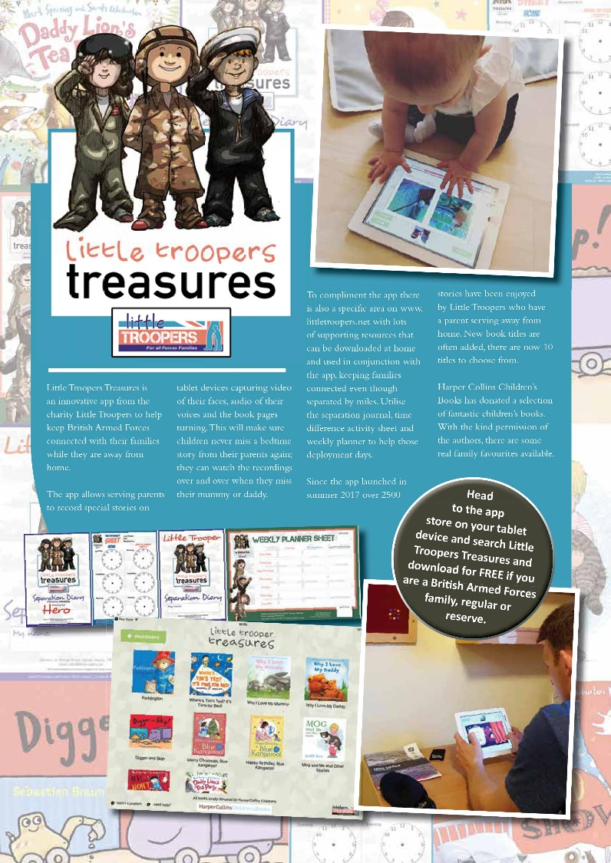
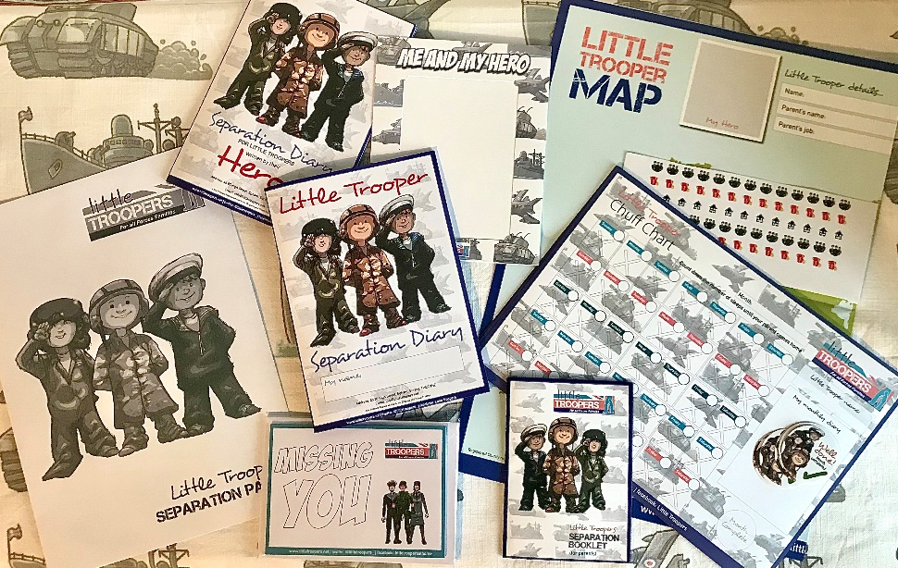
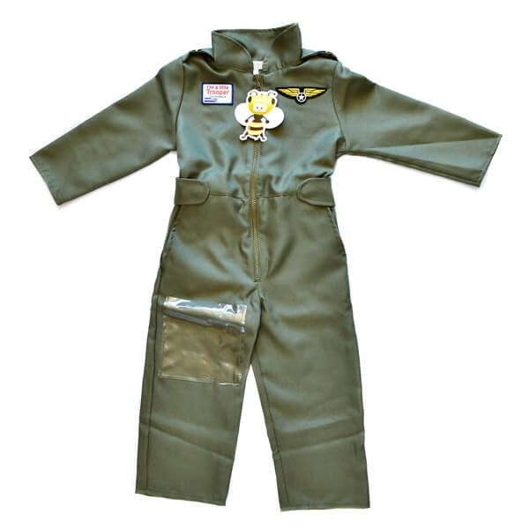
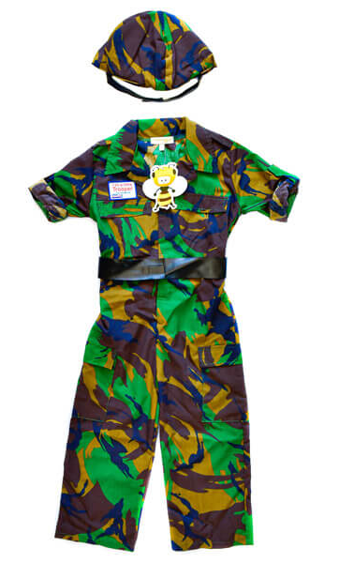
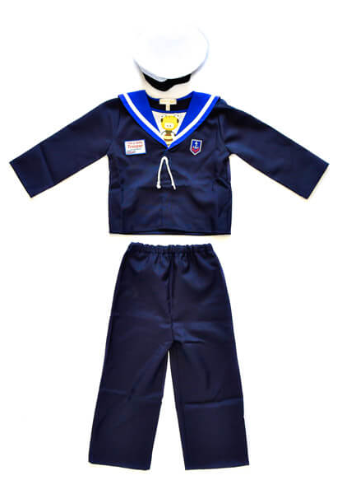
What else?
Little Troopers Treasures app
Separation Pack
Early years outfits
Little Troopers Gazette

Slide 18
The future
Online Toolbox
Expanding specific teenager support provision
Little Troopers Therapy Programme
Schools conference series

