Slide 1
Shropshire Local Plan Review
‘Preferred Sites’ Consultation
29th November 2018 - 8th February 2019
LUDLOW PLACE PLAN AREA
Ludlow, Burford, Clee Hill
(Liam Cowden – Principal Policy Officer)

Slide 2
Local Plan Review
Shropshire Development Plan (Core Strategy & SAMDev Plan) to be updated:
  Implementing SAMDev Inspector’s recommendation to:
    review Shropshire Green Belt
    assess objective development needs
    re-appraise distribution of development
  extending planned time horizon to 2036 (& 2056 in Green Belt)
  reflecting national planning policy (2018 revision)
  sustaining 5 year housing land supply in Shropshire
  maintaining local management of planning decisions

Slide 3
Local Development Scheme
Work so Far
The Local Development Scheme is the project plan for the Local Plan Review available at: https://shropshire.gov.uk/planning-policy/local-planning/local-development-scheme-lds/
Adoption
2021
Independent Examination
2020
Submission Final Plan
December 2019
Consultation Final Plan
October 2019
We are here
Preferred Options:
Consultation on Preferred Sites
NOVEMBER 2018
Preferred Options:
Scale and Distribution of Development
October 2017
Issues & Strategic Options
January 2017

Slide 4
Proposed Scale of Growth
Scale & Distribution of Development consultation (October - December 2017) recommended:
housing growth of 28,750 dwellings (at 1,430 per year) in ‘Urban Focused’ distribution to deliver the following proportions:
  Shrewsbury – 30%
  Principal Centres – 24.5%
  Key Centres – 18%
  Rural Areas – 27.5%
balanced employment growth of 300 hectares (at 15 hectares per year)
additional new site allocations to deliver around 10,250 dwellings and to deliver over 80 hectares of employment land
Potential strategic sites – for Garden Villages & strategic employment sites at Ironbridge Power Station, Clive Barracks & M54 corridor in separate consultation during Spring 2019

Slide 5
Preferred Sites Consultation
Preferred Sites consultation (November 2018 – February 2019) recommends:
The hierarchy of settlements:
    Shrewsbury & Principal Centres
    Key Centres
    Community Hubs & Community Clusters
Preferred development guidelines and development boundaries for Shrewsbury, Principal and Key Centres and Community Hubs
Preferred sites to deliver the scale and distribution of development
Housing policy direction to increase the delivery of affordable housing through the cross-subsidy from including low cost or open market housing in the scheme. Eligibility based on either:
  Bespoke site by site assessments;
  Set percentages using county Viability Report

Slide 6
Preferred Strategy - Ludlow
Residential Requirements | Number of Dwellings
Preferred dwelling guideline 2016-2036 | 1,000
Dwellings completed in 2016-17 | 14
Dwellings committed as at 31st March 2017 | 840
Remaining dwelling requirement to be identified | 146
Dwellings to be allocated | 84
Balance/Windfall allowance* | 62
*Local Plan policies will allow flexibility for appropriate windfall, rural exception and cross-subsidy development.
Employment Requirements | Number of Hectares
Preferred employment guideline 2016-2036 | 11
Commitments and allocations as at 31st March 2017 | 7
Employment land shortfall | 4
Employment land to be allocated | 4
Balance/Windfall allowance* | 0
*Local Plan policies will allow flexibility for appropriate windfall development.

Slide 7
Preferred Strategy - Ludlow
Rationale for the Preferred Strategy for Ludlow:
Limited scale of additional development (i.e. for 146 houses and 4 hectares of employment land) will allow slower growth east of the A49 up to 2036
Ludlow should have a predominantly town based strategy to 2036
This strategy should separate housing and employment uses to protect the historic character and amenity of the town – rather than mixed use sites !
Focus for planning to 2036 should be to deliver the significant, existing commitments in the town and to the east of the A49
Future planning of Ludlow beyond 2036 should consider the continuing growth east of the A49 and how to:
  plan this physical development to protect the setting of the historic town
  sustain community cohesion across the physical barrier of the A49

Slide 8
Potential Sites – Ludlow

Slide 9
Preferred Strategy – Ludlow

Slide 10
Preferred Strategy – Clee Hill

Slide 11
Potential Sites – Clee Hill

Slide 12
Preferred Strategy – Clee Hill

Slide 13
Preferred Strategy – Burford

Slide 14
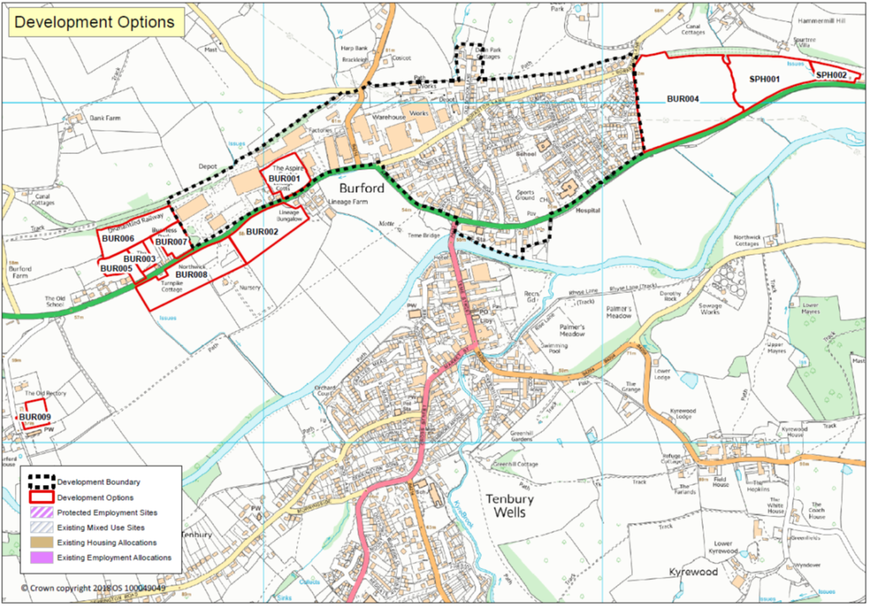
Potential Sites – Burford

Slide 15
Development Boundary – Burford

Slide 16
Community Clusters
A Community Cluster is a group of smaller settlements that together offer a range of services and collectively create a sustainable community
Parish Councils may still identify (‘opt-in’) settlements in their area to be designated as Community Clusters
Community Clusters have a criteria based policy (published October 2017) to permit small scale development proposals within the settlements in the Cluster

Slide 17
Evidence Documents
Evidence documents comprise the following:
Full Objectively Assessed Housing Need (FOAHN)
Strategic Land Availability Assessment (SLAA)
Site Assessments
Hierarchy of Settlements
Productivity Growth Forecast
Landscape and Visual Impact Assessment
Greenbelt Assessment / Review
Strategic Flood Risk Assessment
These are available at: https://www.shropshire.gov.uk/planning-policy/local-planning/local-plan-partial-review-2016-2036/evidence-base/

Slide 18
    QUESTIONS ?
Consultation webpage:
https://shropshire.gov.uk/get-involved/local-plan-review-preferred-sites-consultation/
Consultation Form:
11. Preferred Sites Questionnaire - Ludlow Place Plan Area.pdf Consultation Question 22 : Ludlow

