Slide 1
Shropshire SENCO Network Meeting June 2020

Slide 2
Agenda
Introduction - Housekeeping
DfE / SEN Updates; – Julia Dean
Educational Psychology Services; Support / Guidance – Chantal Goss
Woodlands Support; – Kat Edmonds
Spectra
Updates;

Slide 3
DfE / SEN Updates; Julia Dean (SEN Service Manager)

Slide 4
Reasonable Endeavours
https://www.gov.uk/government/publications/changes-to-the-law-on-education-health-and-care-needs-assessments-and-plans-due-to-coronavirus
Feedback – Surveys, Phone calls
Individualised, not ‘Blanket’
Record – Template
Ideas / strategies?

Slide 5
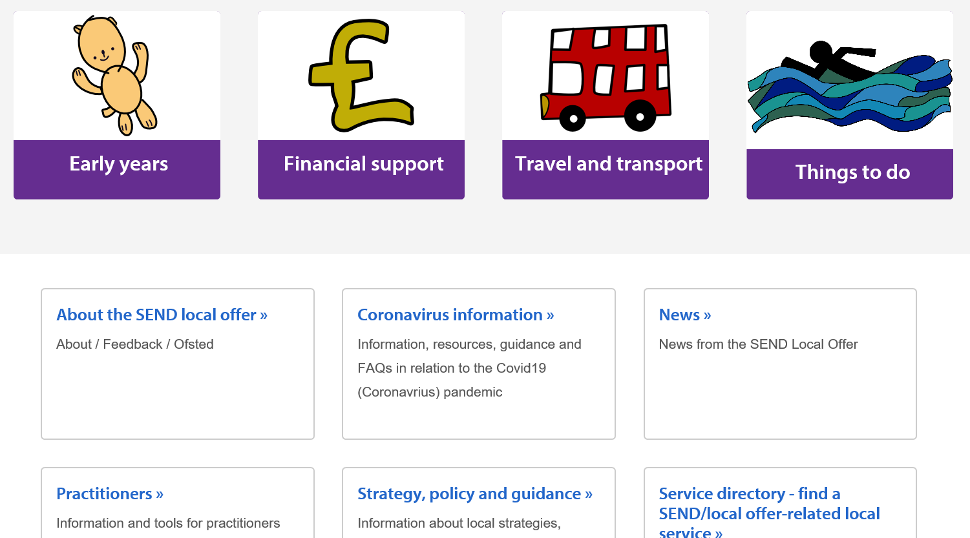
SEND Local Offer

Slide 6
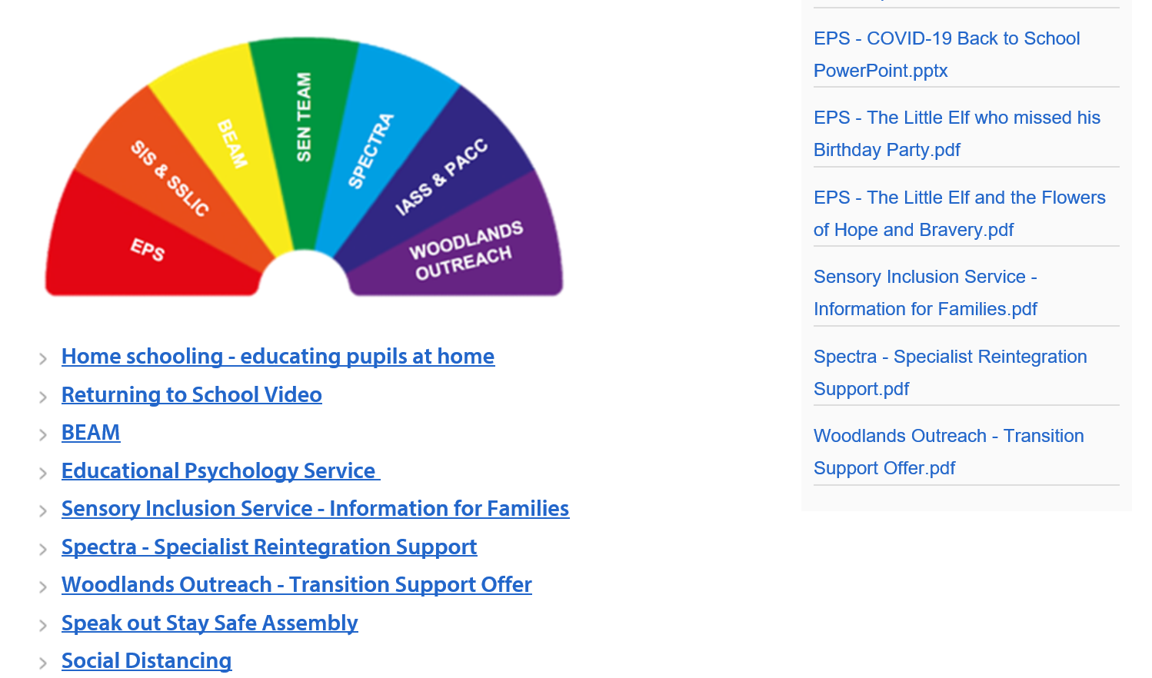
SEND Local Offer

Slide 7
SEN Team Updates
SEN Team Staff Changes;
Sam Edwards – SEN Team Manager
Gemma Breckell - returned from Maternity
Annual Review Officers – Tracey Newell / Kay Wilson
SEN Case Manager
Looking to appoint two SEN Case Co-ordinators

Slide 8
SEN Team Updates
‘Focus on SEND Newsletter’
released last week, sent to schools, also available on the SEND Local Offer
Regular SEN updates circulated through the Headteacher emails to school
Risk Assessments: Up-date regularly,
All SEN children are entitled to a place
Local Area Inspection Written Statement of Action - 6 points

Slide 9
SEN Team Updates
Annual Reviews Focus on timely response
Continue to conduct AR’s within time frame – statutory expectation
SEN Team representation / ‘virtual attendance’
SEN Support / GSP Updated guidance and paperwork. Share next network meetings
Specialist Equipment – regular servicing requirement
During the period that schools are only open to vulnerable pupils or those with EHCP’s – it is important that the regular servicing of equipment is maintained. The Health and Safety Executive (HSE) has indicated that all servicing should be adhered to even in the current times. Please can I ask that if you have any equipment that is close to reaching the service date you ensure that this is followed up as appropriate. I understand that the pupil who is supported by the equipment may not currently be accessing school, but by the service taking place when due it will ensure that the equipment is safe to be used on their return.

Slide 10
SEN Team Updates
Other Services; SIS, SSLIC available for support
Feedback; Conversations with Parents/Carers
Video clips/Photo
Any Other business

