Slide 1
WHAT TO EXPECT FROM
Emotional Wellbeing drop-in for children and young people aged 0-25, their parents and carers.
service provided by

Slide 2
Who are we?
Beam is operated by The Children’s Society, a national charity that works with the most vulnerable children and young people in Britain today.
We listen. We support. We act.
Because we believe no child should feel alone.
Our beliefs and values
Brave We are brave, fighting injustice at every level, fearless in our determination to be listened to. We expose and directly address ‘hard truths’ and are determined to turn words swiftly into actions.
Ambitious We are ambitious for the lives of the children we work with. The pioneering work we do helps them and children across the country aspire to better lives.
Supportive We support children in their personal development and to build positive relationships. Together we enable children to reach their full potential and realise their ambitions.
Trusted We have been trusted for over a century to deliver care where it is most needed. We maintain that trust by being dependable and consistent in our approach and by fighting for change based on hard evidence.

Slide 3
For more information about the history of our organisation as well as our various projects, please visit our website:
https://www.childrenssociety.org.uk/

Slide 4
The Bee U Partnership
Bee U is the 0-25 Emotional Health & Wellbeing Service based in Shropshire and Telford & Wrekin.
Bee U is made up of:
Drop-in and online services are available as well as Young People and Families Mental Health Service (previously CAMHS) to give help, advice, and risk support.

Slide 5
What does Beam do?
Our Aim
“to provide children and young people aged 0 – 25, their parents/ carers & professionals with advice, signposting and support with any concerns relating to mental and emotional wellbeing.”
Our team is very passionate about empowering young people. Simply listening to a young person’s experience or using therapeutic strategies and providing information can make all the difference.
…we want to help you acquire the resilience and skills you need when life throws up challenges. We want you to know what to do for yourself if you are troubled by emotions or problems with your mental health
https://www.gov.uk/government/uploads/system/uploads/attachment_data/file/414024/Childrens_Mental_Health.pdf

Slide 6
Who are Beam?
Beam is a multi-disciplinary team made up of Therapists, Youth Workers and Wellbeing Volunteers.
Our background & experience
Young offenders | NHS & IAPT | Education & support | Mental Health Nursing
Sexual violence | Counselling | Teaching | Eating disorders
CBT | School pastoral support | Trauma | Residential care
Mentoring | Attachment | Students | Assistant psychologists
Behaviour management | Youth work | Occupational therapy | Children’s rights
Domestic Violence | British Sign Language | Mental health first aid | Childhood sexual exploitation

Slide 7
Above all, every team member has a genuine enthusiasm for working with CYP and their families, and many of those within our team are parents of children with special educational needs.

Slide 8
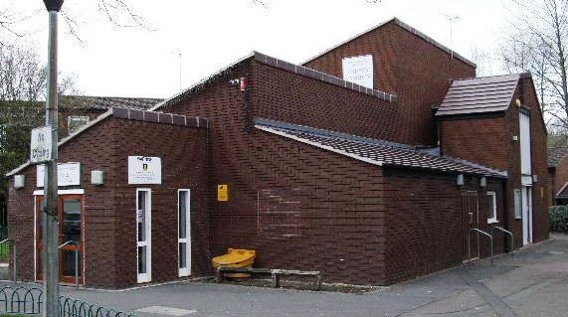
When & Where is Beam?
Telford & Wrekin | Shropshire
Mondays. 2pm – 6pm | Thursdays. 2pm – 6pm
Hollinswood Neighbourhood Centre, Hollinswood, Telford TF3 2EW | Upstairs @ Palmers Coffee Shop, Claremont Street, Shrewsbury, SY1 1QG
We also operate drop-ins for students at Telford College.
Please contact us for more info about these.

Slide 9
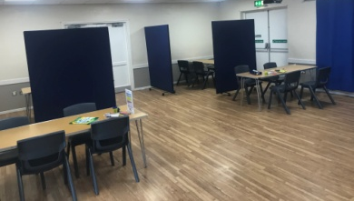
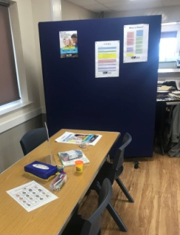
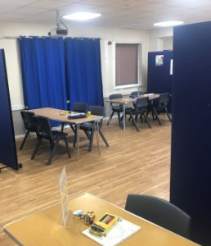
What does Beam look like?
Telford & Wrekin – currently at Hollinswood
We are in the process of renovating a new, permanent venue in Wellington Town Centre. Once complete, the Telford & Wrekin service will run solely from there.
This will mean there will be increased drop in sessions, as well as more ways to access support.
This venue will be open for users from across the county.

Slide 10
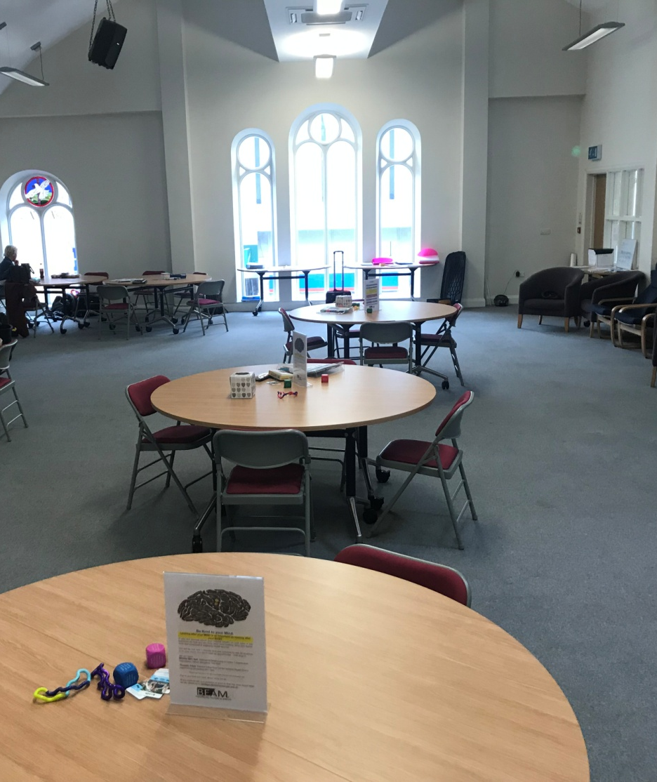
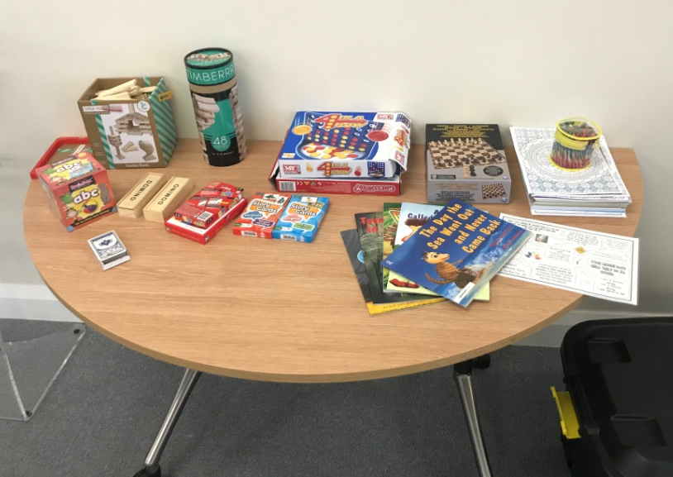
What does Beam look like?
Shropshire - Upstairs @ Palmers, Shrewsbury

Slide 11
Registration & Consent
On the initial visit, children, young people, parents and carers will be asked to complete our registration and consent forms.
This is required before we can commence working with them.
We will also ask for professionals to complete a registration form, detailing the organisation they work for as well as their contact details.
You will be asked to complete a feedback form at the end of your visit. These are anonymous and help us to make improvements where needed.

Slide 12
Who can use Beam?
Anyone between the ages of 0-25 can access support from Beam.
Parents and carer support is given provided it is in conjunction with a young person.

Slide 13
What will Beam do?
 | We can provide low-intensity therapeutic support under a brief therapy framework.
 | We promote psycho-education.
 | We give practical support and suggestions.
 | We listen, trying our best to ensure our service users feel heard.
 | We adapt: we know there is no such thing as one size fits all.

Slide 14
What won’t Beam do?
 | We do not deliver structured therapy.
 | We do not complete assessments.
 | We do not diagnose.
 | We do not automatically make referrals.
 | We do not offer an appointment system.

Slide 15
FAQ’s
What if a parent/carer wants to come along without their child?
This is fine. We appreciate that people can find it difficult to discuss their circumstances while their child or children are sat with them. We welcome visits from parents and carers who want to see what the drop-in is like before they bring their child(ren).
What if a young person wants to come without their parent/carer?
We are happy for age-appropriate young people to attend Beam alone. They do not need permission to come, and we don’t automatically share with anyone that they have attended. We require consent from the parent/carers of children aged 13 and under, and this is reflected on the consent form. In instances where individuals aged13 and below attend the drop in alone, we will seek their agreement to obtain consent from a parent/carer over the phone.
Do parents/carers need to wait while their child is seen?
It is important that the parents/carers of younger children stay at drop-in while their child is attending Beam.
What happens if a risk is identified?
Our clinical staff will raise and follow up any risk or safeguarding concern through the relevant channels, and would seek to obtain the individual’s informed consent in the first instance before doing this.

Slide 16
Which drop in should I attend?
Shropshire and Telford & Wrekin users can access either of our drop ins in Shrewsbury or Telford.
Do I / does my child need to have a diagnosis to come?
No.
Can we make an appointment?
No. We operate solely on a drop-in basis. This is to ensure we can be as accessible as possible to all during the hours we are open. This may mean that at busier times there is a wait to be seen. We try and make this as comfortable as possible by offering refreshments, as well as games or activities to entertain children and young people.
Can I see the same person?
As we are a drop-in, we cannot guarantee that you will see the same person each visit. After each session, brief notes will be written about what has been discussed, and these will be reviewed on your next visit prior to you being seen. Please be reassured there shouldn’t be a need to go over what you had discussed the week before.

Slide 17
e-mail us:
askBeam@childrenssociety.org.uk

